Slide 1
TELECOM CUSTOMER CHURN PREDICTION
A case study on analysis churn in Telecom and building a machine learning model to classify the customer who is likely to churn
Aayush Jain

Slide 2

ABOUT PROJECT
What is Churn ?
Churn Prediction is use case in business consist of detecting customer who are likely to cancel the subscription of service.
The telecom company provides telecom services to many clients. But due to many reasons. customers switch from one service provider to other. Telecom churn has emerged as the single largest cause of revenue erosion for telecom operators.
Now telecom company wants to know actionable insights to retain customers and increase customers’ lifetime values.

Slide 3
Project OBJECTIVE
To predict Customer Churn
Highlight main features influencing customer churn.
Use Machine Learning algorithms to build predictive models, evaluate accuracy and performance of these models.

Slide 4
APPROACH
Problem Statement
Data Collection
Exploratory Data Analysis
Model Deploy
Feature Engineering
Performance Evaluate
Model Training

Slide 5
Data Collection
Goal: Analyze telecommunication company customer data to predict whether or not a customer is likely to leave the platform (churn)
Data from 7043 customers (21 features):
○ Churn (Yes or No)
○ Customer account information (tenure, contract, payments, etc.)
○ Demographic Information (Partner, Gender, Age, etc.)
○ Add-on services provided by the platform
Source: Kaggle.com

Slide 6
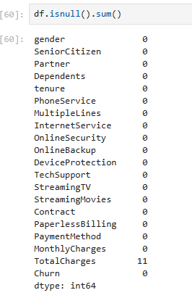
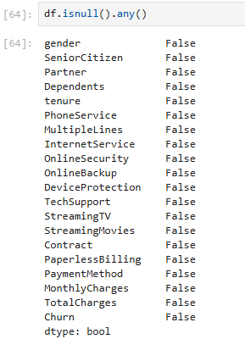
DATA PREPROCESSING
Checking NULL values and drop rows having NULL values.
df.dropna(inplace=True)

Slide 7


DATA PREPROCESSING
Checking Duplicate values and drop rows having Duplicate values.
df.drop_duplicates(inplace=True)

Slide 8
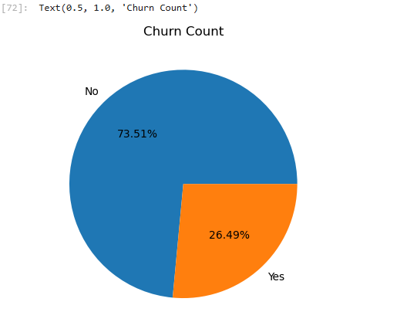
Exploratory DATA ANALYSIS
Target- Customer Churn

Slide 9
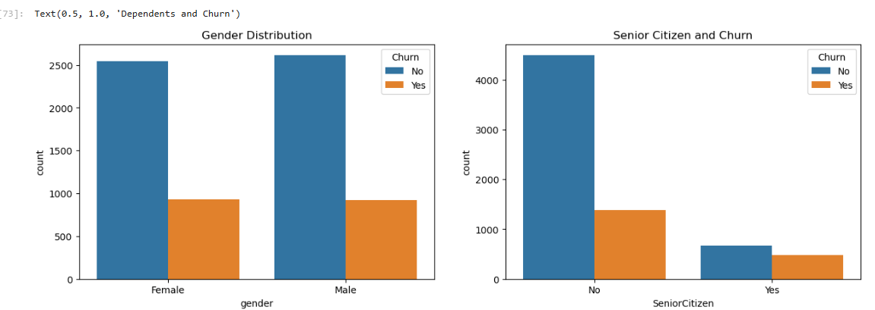
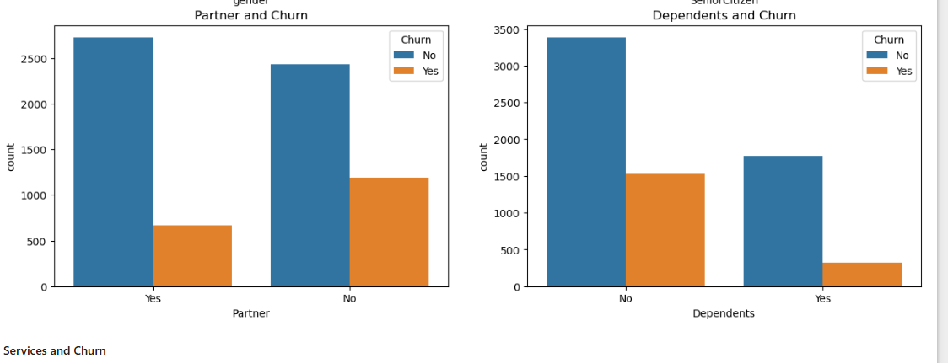
OUR CUSTOMERS

Slide 10
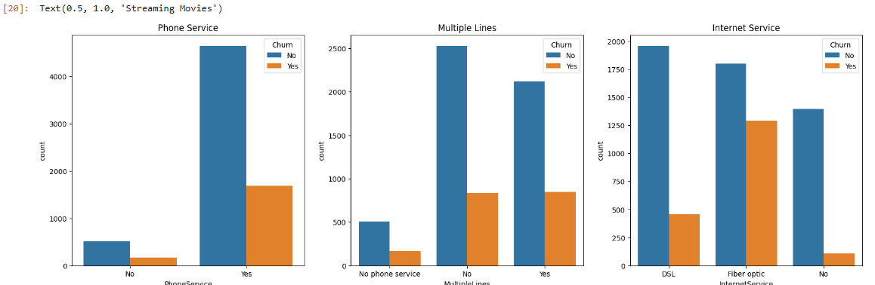
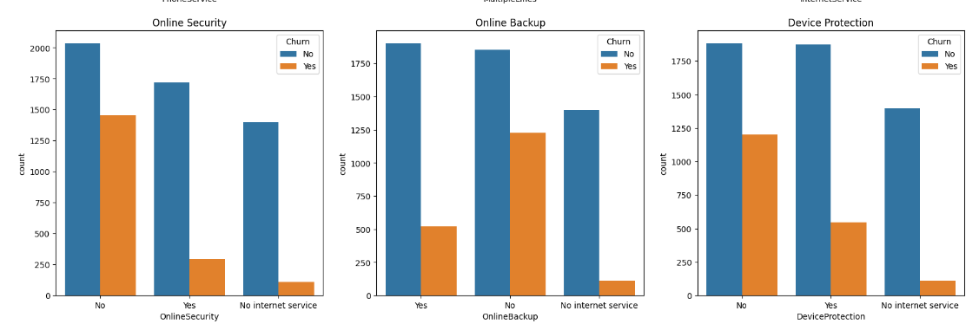
OUR CUSTOMERS

Slide 11
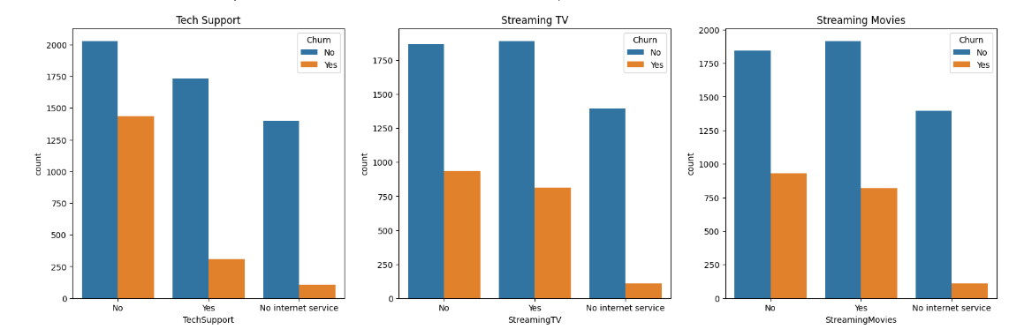
OUR CUSTOMERS

Slide 12
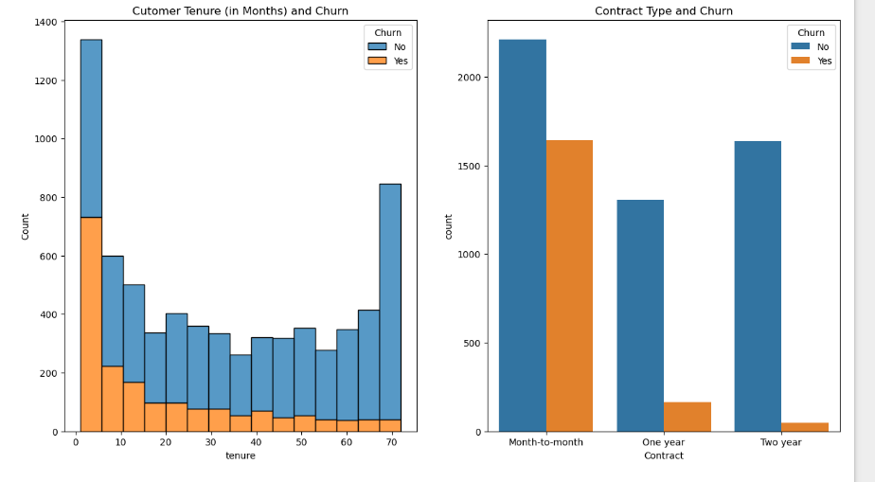
OUR CUSTOMERS

Slide 13
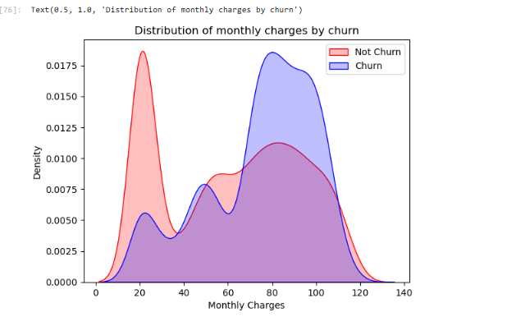
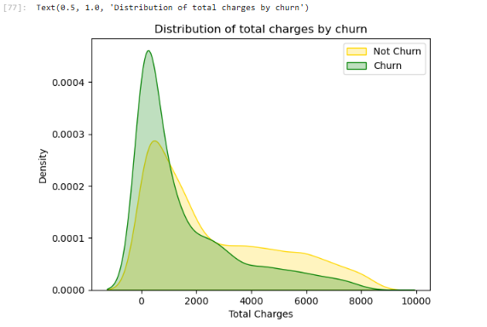
OUR CUSTOMERS

Slide 14
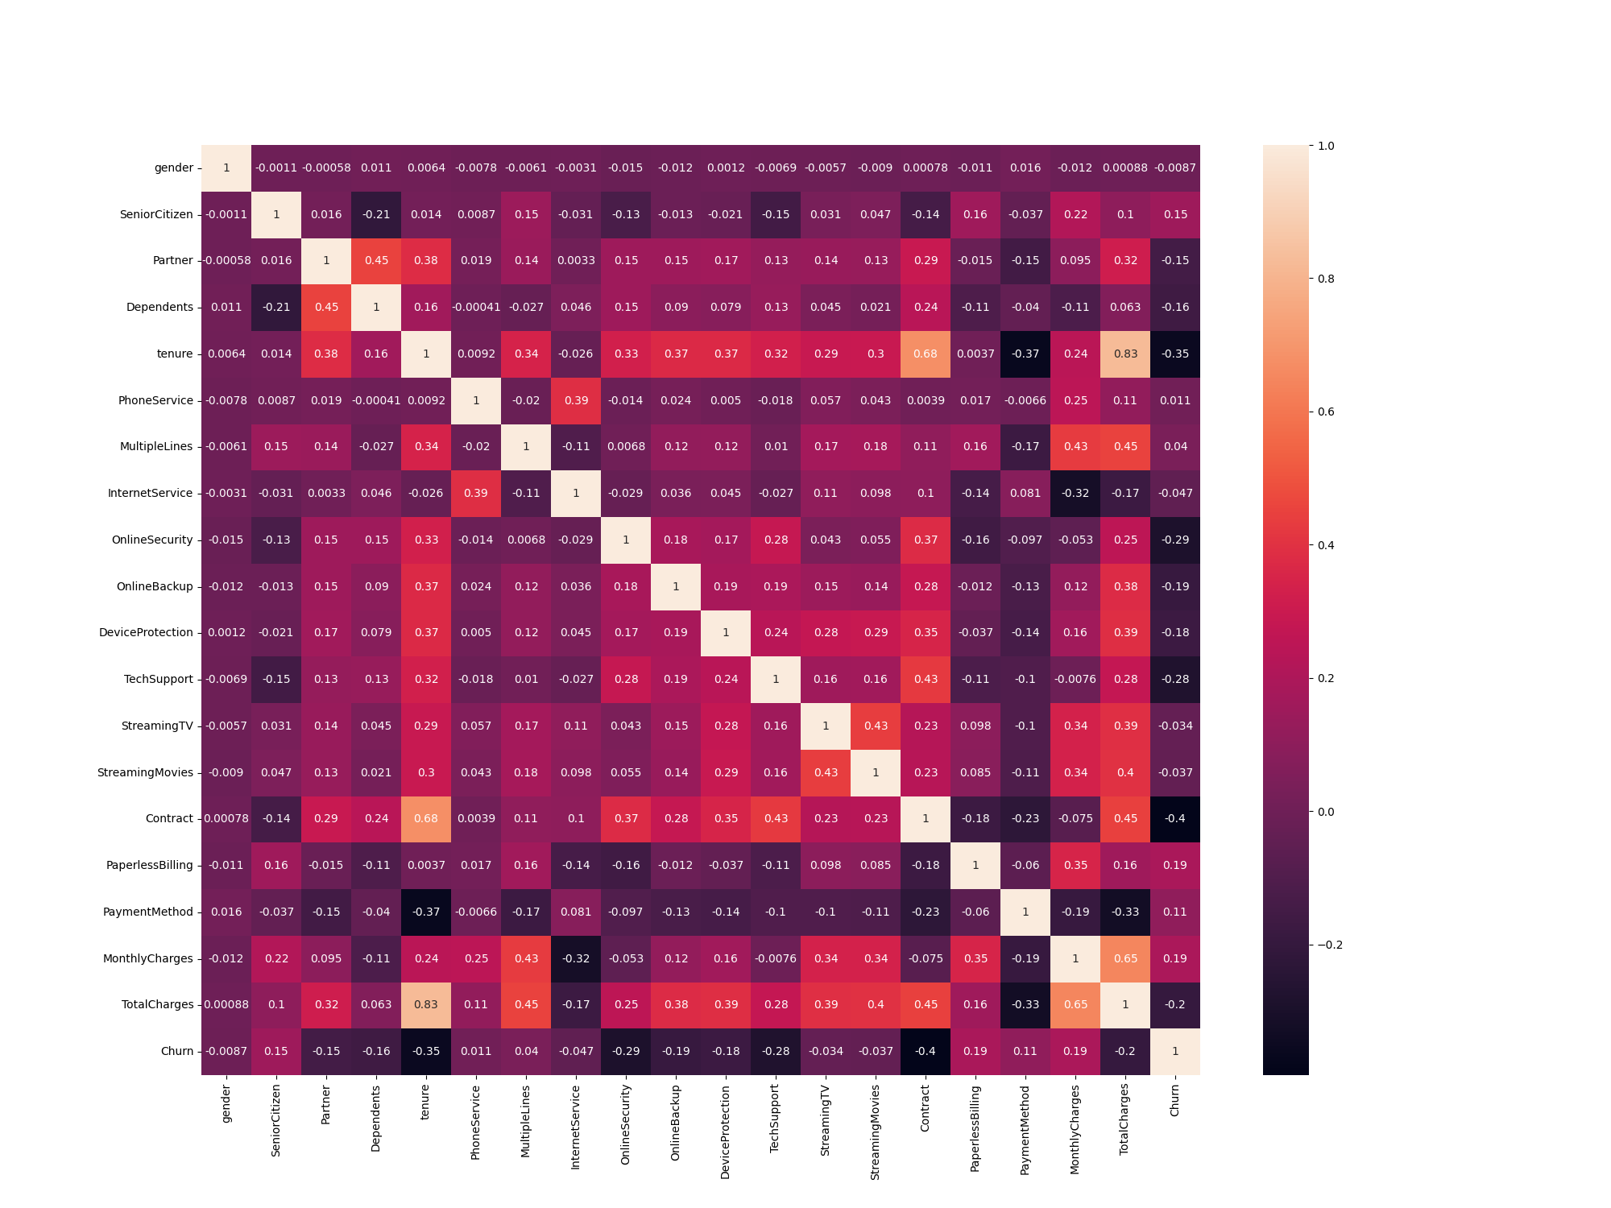
OUR CUSTOMERS
tenure vs. Churn: The negative correlation coefficient (-0.352634) indicates a moderate negative linear relationship between the two variables. As 'tenure' (the duration a customer has been with the company) increases, the 'Churn' rate (the likelihood of a customer churning) tends to decrease.
MonthlyCharges vs. Churn: The positive correlation coefficient (0.201995) indicates a weak positive linear relationship between the two variables. As 'MonthlyCharges' increase, the 'Churn' rate tends to slightly increase. However, the correlation is not as strong as with 'tenure’.
TotalCharges vs. Churn: The negative correlation (-0.194628) suggests a weak negative linear relationship between the two variables. As 'TotalCharges' (the total amount charged to the customer) increases, the 'Churn' rate tends to slightly decrease. However, similar to 'MonthlyCharges', the correlation is not as strong as with 'tenure'.

Slide 15
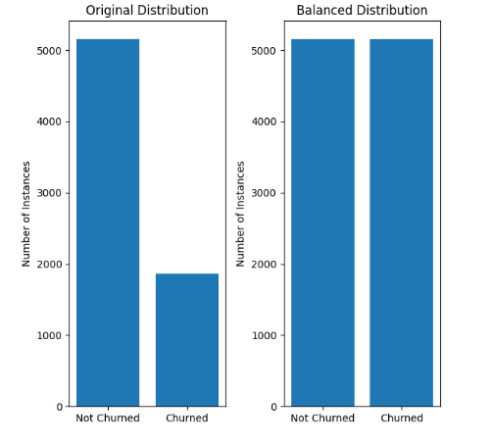
IMBALANCE TARGET CLASS
SMOTE Algorithm:
SMOTE (Synthetic Minority Over-sampling Technique) is a method used to address class imbalance in a binary classification problem.
SMOTE will aim to balance the class distribution by generating synthetic samples until the minority class has the same number of instances as the majority class. By creating synthetic samples, SMOTE helps the model better capture the patterns in the minority class and prevents it from favoring the majority class due to the imbalance.

Slide 16
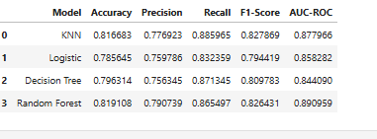
PERFORMANCE EVALUATION
Before Tuning:
After tuning:
 | Decision Tree | Random Forest | Logistic Regression | KNN
Accuracy | 76.77% | 83.26% | 78.51% | 79.58%

Slide 17
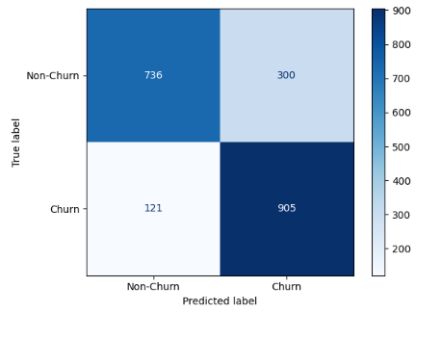
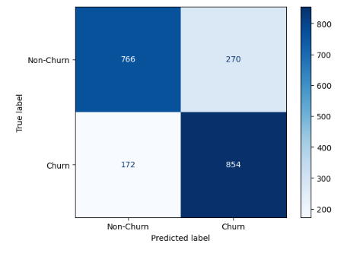
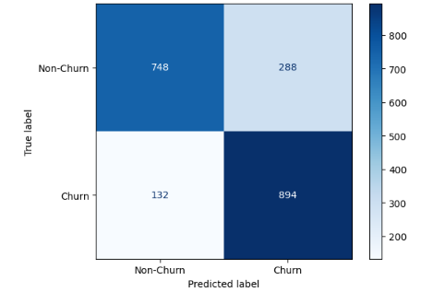
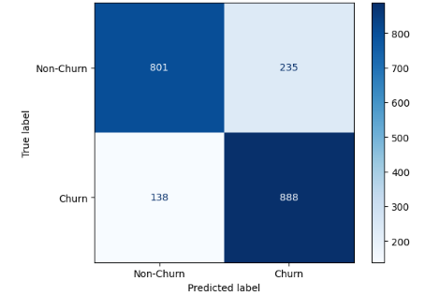
PERFORMANCE EVALUATION
Confusion Matrix:
KNN | Logistic Regression | Decision Tree | Random Forest

Slide 18
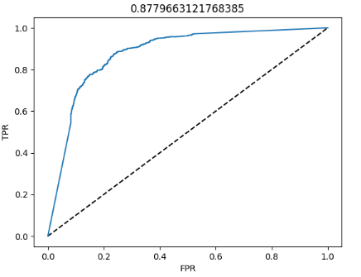
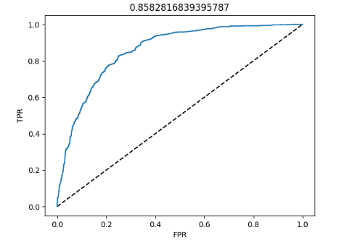
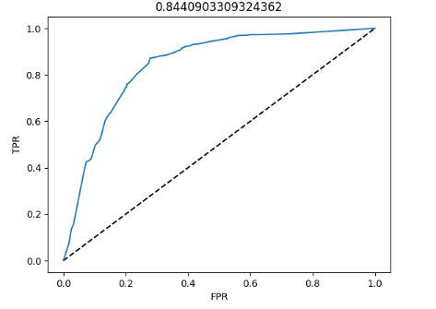
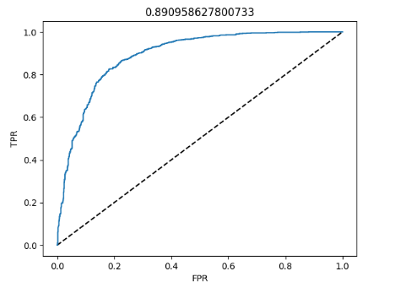
PERFORMANCE EVALUATION
AUC ROC Curve:
KNN
Logistic
Regression
Decision
Tree
Random
Forest

Slide 19
Conclusion
Random Forest shows more accuracy. So, we choose Random Forest ML model for prediction of the customer churn.
For deploying I have used flask in the backend and and in the frontend I have used HTML, CSS.

Slide 20
THANK YOU

